Slide 1




Module Name - Conditionals, Loops & Functions
Class - Day 3
Topic Name- Basics of Functions
EditEdit MasterMaster texttext stylesstyles

Slide 2
Today’s Agenda
Introduction to Functions
Characteristics of a Function
Passing Parameters into Function
Pass by value concept

Slide 3
Today’s Agenda
Inbuilt Functions in Java
Reading from a file
Exceptions
try catch
throws Statement
Writing to a File

Slide 4

Introduction to Functions
In programming, you’ll observe that at times there will be a need of reusability of some part of the code.
You have seen the code to print even numbers.
Now suppose you are required to print these
numbers multiple times. Then writing that
code snippet multiple times would be very hectic.

Slide 5

Introduction to Functions
Fortunately, Java provides a provision to reuse the code multiple times without writing it again. This is achieved using Functions in Java.
The whole code snippet can be wrapped
inside a function and the function can be
called as many number of times as one wants
to repeat the code.

Slide 6
Introduction to Functions
Let us start with some inbuilt functions in Java which proves very helpful in performing various tasks.
For eg: String name = “John”;
int a = name.length();
// length() is an inbuilt function which has some code
// wrapped inside it internally which calculates the
// length of the string and returns it. Here, 4 will
// be returned.

Slide 7
Introduction to Functions
char b = name.charAt(2);
// charAt(i) is an inbuilt function which finds out the character of a string variable at the ith index and return it. Like, here the character at index 2 i.e ‘h’ will be returned & stored in variable b.

Slide 8

Characteristics of a Function
Characteristics of a Function
It should have a name.
It should execute some statement/
statements.
It should be called whenever those statements are to be executed.

Slide 9
Characteristics of a Function
Now, function definition starts with either a return type or void.
In case of void, the function does not return any value. Only the statements inside the function are executed and nothing is returned when the function is called.
When the function is defined using a return type, then a value of the same data type is returned which was used to define the function.

Slide 10
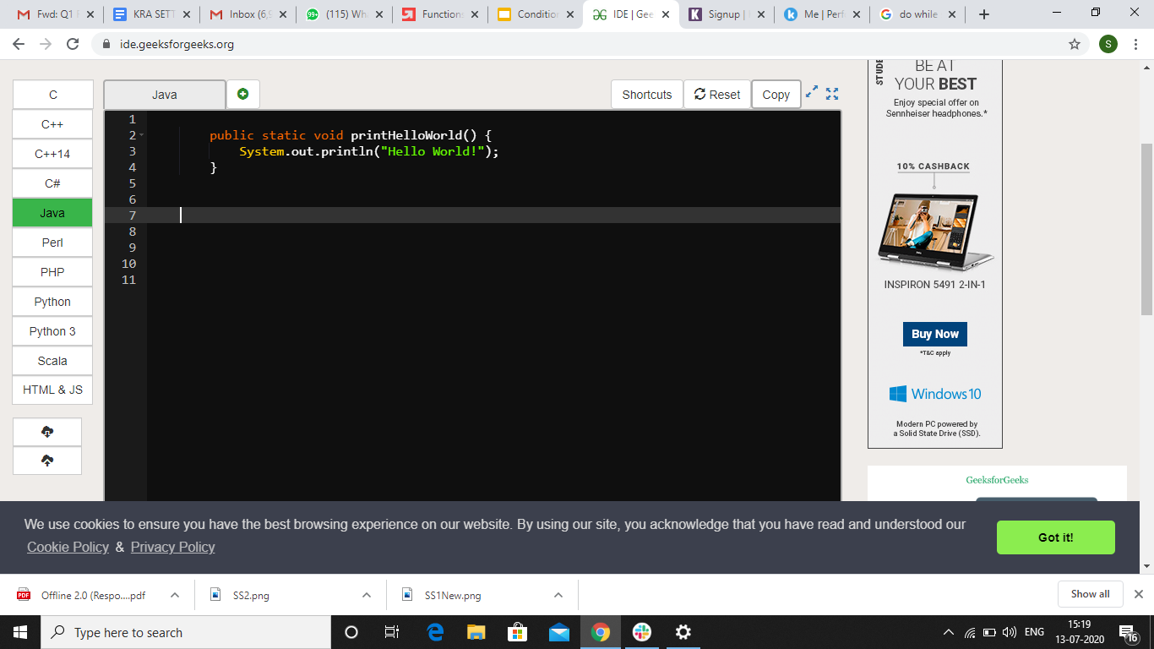
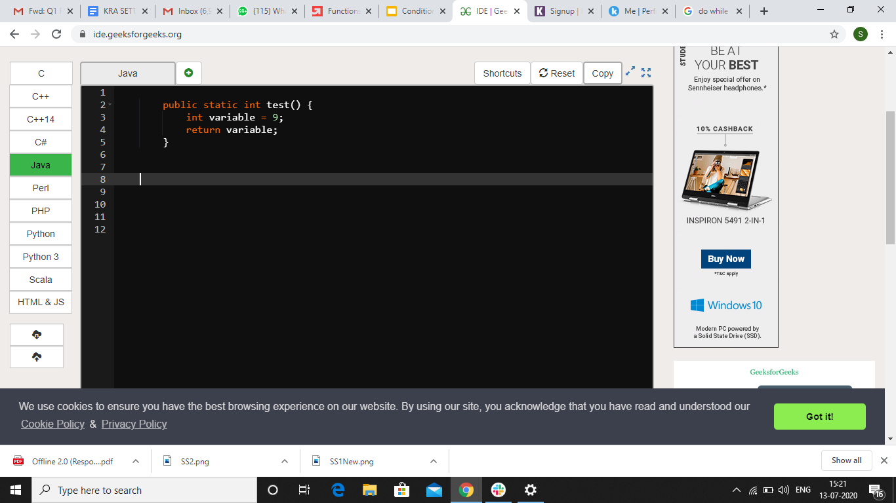
Characteristics of a Function
void is used which means that no value will be returned and only this print statement will be executed.
int is used as return type so an integer value has to be returned. Like, variable having value 9 is returned here.

Slide 11
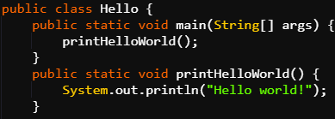
Functions: Examples
Example 1: Code to print Hello World
Java Code: Functions
Notes:
public and static will be explained later

Slide 12

Functions: Examples
It is a void function, so no value will be returned.
The name of the function is printHelloWorld().
Function is always called using its name. Like
here, it is called in main method using
printHelloWorld(); statement.
Inside the function definition, a print statement is made which prints Hello World!.

Slide 13
Functions: Examples
This print statement will be executed whenever the function will be called. Here, the function is called only once in the main method, so Hello World! Will be printed once.
Had it been called four times, the print statement would have been executed four times and hence Hello World! would have been printed four times.

Slide 14
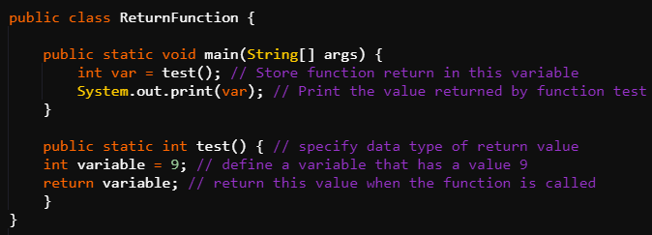
Functions: Examples
Example 2: Code to print integer 9 using functions.
Java Code: Functions

Slide 15
Functions: Examples
The return type of the function is int so an integer value has to be returned or else it will throw an error.
Name of the function is test().
The function definition says that an integer variable named variable and having value 9 will be returned when function is called.

Slide 16
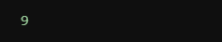
Functions: Examples
Inside the main method, the test() function is called and the returned value is stored in another integer variable named var.
Then, print statement is made for var. Since, 9 was returned from test(), so 9 will be printed on printing var.

Slide 17

Passing Parameters
There is a very interesting concept in Java which allows the functions to interact more with the code rather than just performing actions based on predefined values.
This concept is passing of parameters inside
function. The values which are passed as
parameters are called arguments.

Slide 18
Passing Parameters
Passing Parameters in Functions
Parameters are passed inside parenthesis when the function is called.
For eg: abc(9); // An integer value 9 is passed as
// parameter
The data type of the parameter passed has to be mentioned in the parenthesis of the function name when function is defined.

Slide 19
Passing Parameters
Similarly, a variable name will also be given which will collect the value of parameter passed and then will be used locally inside the function.
For eg: public static void abc(int x) // x will collect value 9
{
// x can be used here as a local variable
}

Slide 20
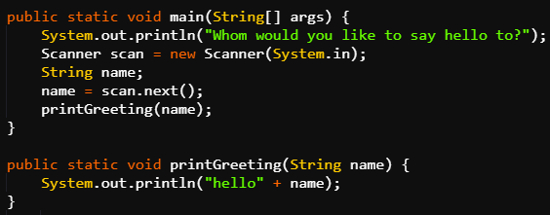
Passing Parameters
Example 1: Code to input a name, pass it as a parameter and print it concatenated with “Hello”.
Java Code: Passing Parameter in Functions

Slide 21
Passing Parameters
A String value is taken as input from user and stored in variable name.
This variable named name is passed as parameter inside parentheses when printGreeting() function is called.
While defining the printGreeting() function, another String variable named name is defined which will act as a local variable to this function.

Slide 22
Passing Parameters
This variable is different from the previous name variable.
Note that it is not compulsory to declare this variable with the same name as the parameter variable.
Now, this name variable will collect the value of previous name variable which was passed as the parameter.

Slide 23
Passing Parameters
The definition of the function is that it will concatenate the value stored in local variable name with “Hello ” and then print it.
So, in the end, whatever String value was given as input by the user will be concatenated with “Hello” and then printed.

Slide 24
Passing Parameters
Multiple parameters can also be passed in a function.
For eg: public static void abc(int a, String b, char c)
{
// a, b, c are local variables to the function // abc
}
abc(9, “Shivam”, ‘A’);
// calling function abc with 3 parameters

Slide 25
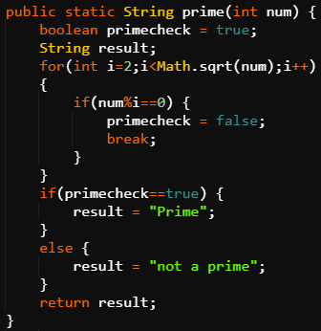
Passing Parameters
Example 2: Code to check if a number is prime or not.
Java Code: Passing Parameter
in Functions

Slide 26
Passing Parameters
That number is passed as an argument in the function prime, so integer variable num contains its value.
The condition for a number to be prime is that it it should not be divisible by any number except 1 and itself.

Slide 27
Passing Parameters
By rules of mathematics, it is known that if it is not divisible by any number from 2 to its square root, then it will not be divisible by any number except 1 and itself. So, the same condition is used in for loop.
Math.sqrt() function is an inbuilt function which is used to calculate the square root of a number. num is passed in its parentheses to calculate the square root of num.

Slide 28
Passing Parameters
Inside the for loop, if num comes out to be divisible by any of the numbers from 2 to sq. root, then boolean primeCheck which was initially declared true is changed to false and the loop breaks.
After the loop, if value of primeCheck is true then String variable result is returned having value “Prime” else “not a Prime” is returned.

Slide 29
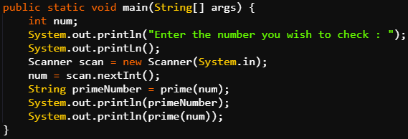
Passing Parameters
Passing Parameter in Functions: Example 2->main method

Slide 30
Passing Parameters
In the main() method, you can observe that prime() function is called twice.
In the first case, the result was stored in a String variable primeNumber and then this variable was printed.
In, the second case, the function was called and printed simultaneously.
It can be done both ways, however, second way saves memory.

Slide 31
Advantage of using Functions
One of the major advantages of using functions is that if something goes wrong, you know where to make corrections that will be reflected in the entire program.
Take two scenarios: one where you are checking prime numbers using the entire elaborate logic, let’s say, 10 times in different places, and you realise that you have made an error. Here, you will have to make corrections in each of these 10 places.

Slide 32
Advantage of using Functions
However, if in the second scenario, you use a function, which essentially reduces the effort required, you can simply make the correction in the function body. It will be reflected in the results.

Slide 33
Pass by Value
So, you have seen various examples where parameters can be passed inside a function.
Java uses the concept of pass by value to pass these arguments.

Slide 34
Pass by Value
Passing by Value
Values are copied into function parameters.
Function is executed on the basis of these copied values.
Original variables remain unchanged.

Slide 35
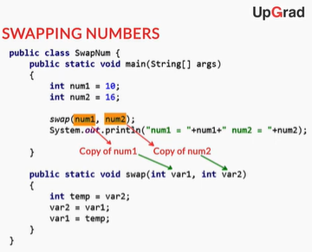
Pass by Value
Pass by Value: Example

Slide 36
Pass by Value
swap() function here is a void function that swaps the value of var1 & var2 using a temp variable.
num1 and num2 are passed as arguments and then they are printed in the main method.

Slide 37
Pass by Value
In the output of the code, the values does not come out as swapped values.
This is because num1 & num2 remain unchanged and var1 & var2 are swapped which are only the copies of num1 & num2.

Slide 38
Pass by Value
There is another mechanism called ‘pass by reference’ in some programming languages, using which, variables can be modified using functions.
But Java does not support pass by reference. It supports only pass by value.

Slide 39
Inbuilt Functions in Java
Inbuilt Functions in Java
These are some predefined functions in Java which have some internal code which helps to perform certain tasks and helps us save time.
Let us see some inbuilt functions one by one.

Slide 40
Inbuilt Functions in Java
System.out.print()
// inbuilt function to print
String abc = “Hello”;
abc.length()
// length() is the inbuilt function which provides // the length of the string
int abs = Math.abs(-9)
// Math is the library and abs() is the function. // It returns the absolute value of a number. Here,
// it will return 9 which will be stored in abs.

Slide 41
Inbuilt Functions in Java
System.out.print(Math.max(a,b));
// max() function will return the bigger value
// between a & b.
String string1 = “hero”;
Boolean a = string1.equals(“Hero”);
// equals() function compares two string values
// and returns a boolean answer. Here it will
// return false as “hero” & “Hero” are different.

Slide 42
Inbuilt Functions in Java
String string1 = “hero”;
String string2 = “honda”;
String string3 = string1.concat(string2);
// concat() function returns the concatenated
// value of first string with the second string.
// Here, it will return “herohonda” which is
// further stored in string3.

Slide 43
Reading from a File
Till now, you created programs that take inputs from users. But what if you want to read a text or numbers from a file on your computer?
You can use some internal libraries in Java to read from files.

Slide 44
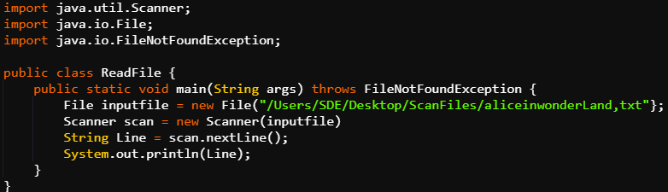
Reading from a File
Code to read lines out of a file
Reading a File

Slide 45
Reading from a File
First of all you have to add a statement throws FileNotFoundException. This helps the system to determine if the file is present or not.
Just like you initialize a variable of type int, here you have to initialize a variable of type File. Path of the file is given in the brackets.

Slide 46
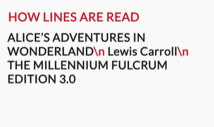
Reading from a File
Scanner class is used to read a file in Java. Instead of System.in, the File variable is passed in the parentheses.
To read line from the text file, nextLine() function is used. It reads the text line by line.
\n is used to separate one line from
another in the text file.

Slide 47
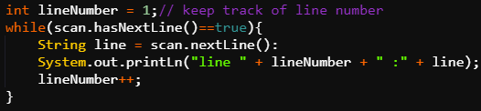
Reading from a File
hasNextLine() is used to check whether the file contains the next line or not. It will return false when there will be no line left. Program remains in loop until all lines are not read line by line.

Slide 48
Reading from a File
If words are to be read instead of lines then next() function is used instead of nextLine().
Also hasNext() is used to check whether there is next word present instead of hasNextLine().
Notes:
Code example which calculates sum of numbers to be explained for more understanding

Slide 49

Exceptions
While writing your programs, you would have encountered many errors. It is indeed very irritating to encounter such errors.
If a user is using your program and encounters
such errors, he/she may lose trust in it.

Slide 50

Exceptions
Let’s say you were loading a website page. The page didn’t load, but you got a simple message saying “Page not found”.
Although there was an error, the website
program was able to identify the error, mask
the original error message, and send out a
simple readable message — “Page not found”.

Slide 51

Exceptions
But what if you got the entire technical message? You would lose trust in the creators of the website.
Thus, you have to handle errors in a
program.

Slide 52
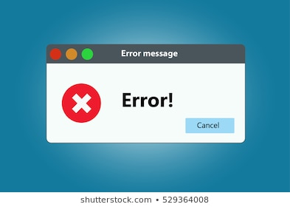
Exceptions
When you run a program, it is first compiled and then executed however when the program is running it may run into errors and stop executing.
These problems and errors are called
exceptions.

Slide 53

Exceptions
What are Exceptions?
Exceptions are disruptions in the normal flow of a program that cause the program to end abnormally.
These exceptions can occur due to
many reasons.
But at times, it is not fair to stop the complete code to execute just because of some exception. In that case try & catch blocks are used.

Slide 54
Exceptions
The code which is expected to throw some error is kept in the try block.
As soon as the error occurs the catch block catches the exception and the catch block gets executed.
When the program finishes executing the catch block, it will execute what comes after the try and catch block.

Slide 55
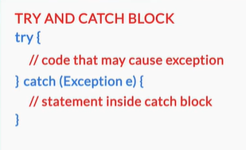
Exceptions
Here’s how a try and catch block looks:
try {
// code that can throw exceptions
} catch (Exception e) {
System.out.println(e);
}
The try block contains the code where exceptions may arise. If an exception occurs, it is caught by the catch block, and the statement inside the block is executed.

Slide 56
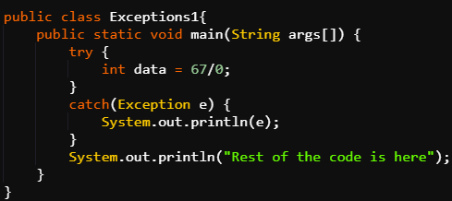
Exceptions
try and Catch Block: Example

Slide 57
Exceptions
The try block contains the code where exceptions may arise. Like here, 67 is being divided by 0 which will result in an exception named Java.lang.ArithmeticException.
So, when the code gets executed this exception pops up but instead of stopping the execution of the remaining code, this exception gets caught in the catch block and is trapped in e.

Slide 58

Exceptions
The catch block has a print statement which prints the value of e and hence the exception gets printed. Then, the rest of the code is executed.
Instead of printing the actual error name in the catch block a user friendly name can also be given to the error and then printed.

Slide 59
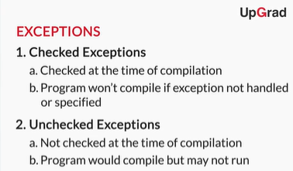
Exceptions
There are two types of exceptions:
Checked exceptions
Unchecked exceptions
Types of Exceptions

Slide 60

Exceptions
Checked Exceptions
These have to be taken care while writing the program. Since they are checked at the time of compilation, if
some statement in your code throws some
checked exception then there must be a
statement to either handle the exception or you
must specify the exception using throws keyword.

Slide 61

Exceptions
Unchecked Exceptions
These exceptions are not checked while the
program is being compiled. Hence there will
be no compilation error even if they are not
checked.

Slide 62
Exceptions
A compile-time error is any type of error that prevents a java program from compiling, e.g. syntax error, incorrect data-types etc. Checked exceptions cause compile time errors if left unhandled.
A runtime error on the other hand arises while the program is running. This could happen due to unexpected user input or an incorrect logic etc.

Slide 63

Exceptions
throws Keyword
This keyword is used to declare that an exception
may arise in the method. Either this or try
catch must be used whenever there is possibility
of an exception.

Slide 64

Exceptions
Like, when the file was read, FileNotFoundException would have been thrown by the scan file statement if
you would have not declared this error in the
method definition using throws keyword.
So, now you know why you used “throws FileNotFoundException” when you were writing
the code to read text from an external file.

Slide 65
Exceptions
The throws keyword specifies that an exception may arise in the particular method.
It is different from try and catch in that it has no provision to handle the exception and thus, it can’t catch the error and execute the corresponding action, e.g. displaying a different simplified message to the user.

Slide 66

Writing to a File
You already learnt how to read from a file. What if you want to write to file?
Let’s say your boss asks you to read some data from
a database, aggregate it and write it on a spreadsheet.
Now this can be done efficiently using programming language. You’ll need a feature called FileWriter. You’ll also need try and catch to catch exceptions that the code for writing to a file may throw.

Slide 67
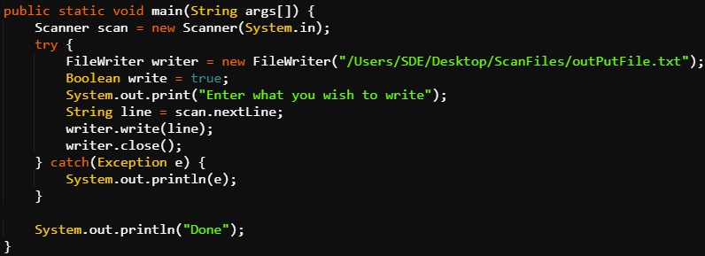
Writing to a File
Writing to a File

Slide 68

Writing to a File
writer variable of type FileWriter(pre defined class) is used to communicate and write the results in a file.
You’ll initialize the variable write to true to
start the writer.
Path of the file in which you want to write is
given in the parentheses of FileWriter.

Slide 69

Writing to a File
nextLine() method is used to input the line which you need to add. This line is stored in a String variable line.
This line is written to the file using write()
method.
writer.write(line);
Then writer is closed using close() method.
writer.close();

Slide 70

Thank you!
#LifeKoKaroLift

